Slide 1
Multi-objective Mining using Genetic Algorithms (Ghosh & Nath, 2004)
Presentation by Damon Bruccoleri
Nova South-Eastern University

Slide 2
Agenda
Introduce Pareto-optimal Solution Set
Introduce Association Rule Mining
Multi-Objective rule mining using genetic algorithms (Ghosh & Nath, 2004)
Contribution
Multi-Objectives
Support Count
Interestingness
Comprehension
The proposed method
Chromosome encoding
Researchers Methodology
Proposal to extend the Research
Methodology to extend the Research
References

Slide 3
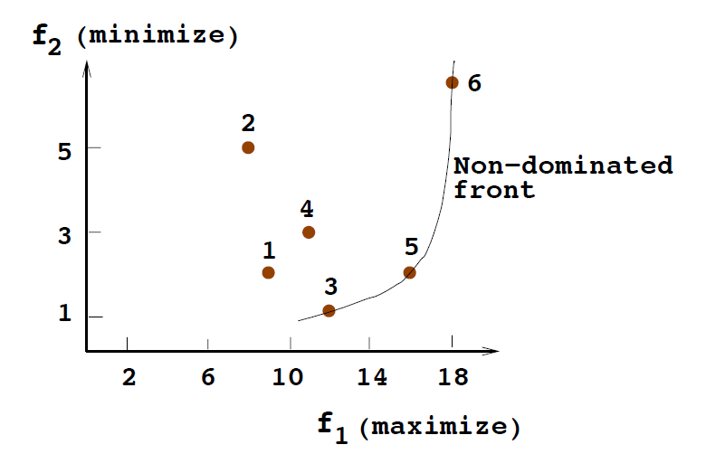
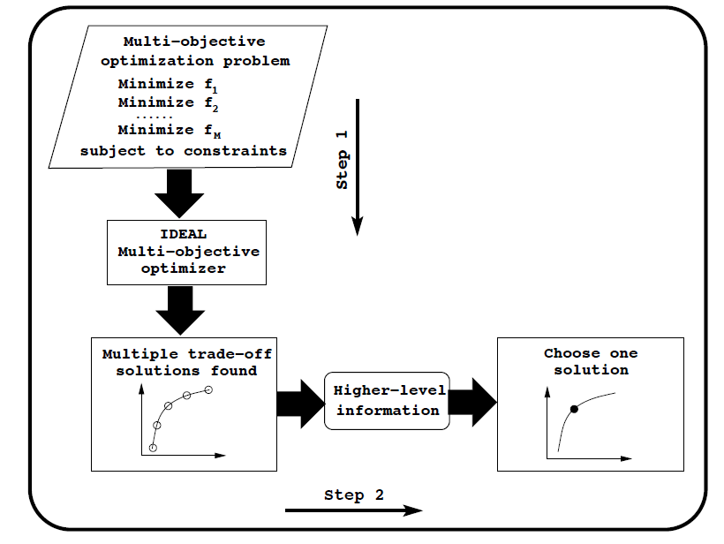
Pareto-Optimal Solution Set
Selection of a Non-dominated solution requires “higher level” knowledge/selection.
Figures adapted from “Multi-Objective Evolutionary Algorithms” (Deb, 2001)

Slide 4
Association Rule Mining
A frequent itemset is of the form {Bread, Eggs, Milk}
Association rules are of the form: Bread, Eggs → Milk
Used by retailers to find interesting market basket analysis, medical diagnosis, protein sequences, fraud detection in web data,…, from databases of those items.
Bread, Eggs are the antecedent. Milk is the consequent.
Rules are extracted from frequent item-sets. Frequent item-sets are extracted from a database.
Frequent item-sets are frequent if they meet the support count objective from the database.
A rule is frequent if it meets a confidence count objective.
Support and Confidence are simply the number of times those item-sets/rules occur in the database.

Slide 5
Contribution of Article
“A number of algorithms for Association Rule Mining have been developed. This research is the first to visualize Mining as a multi-objective problem rather than a single objective problem; thereby removing some of the limitations of the existing approaches.” (Ghosh & Nath, 2004)

Slide 6
Support and Confidence Objectives
Frequent itemset Support threshold is number of times item-set i_{x} occurs in database D supp(i_{x}) = |i_{x} ∩ D|
Association rule Confidence defined as

Slide 7
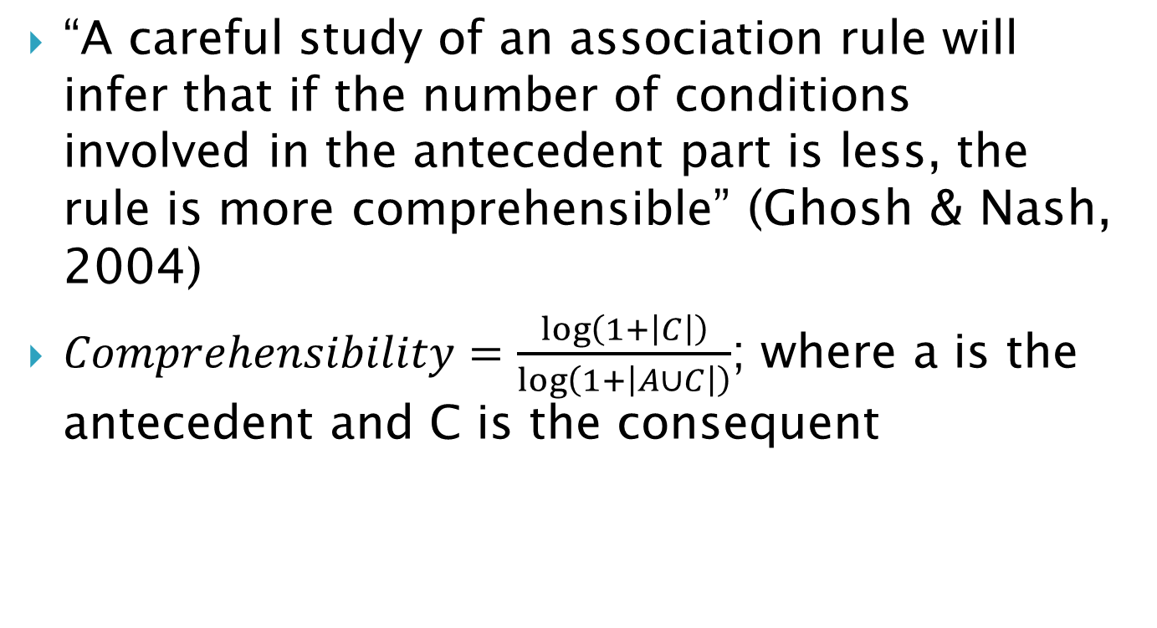
“Comprehensibility” Objective
“A careful study of an association rule will infer that if the number of conditions involved in the antecedent part is less, the rule is more comprehensible” (Ghosh & Nash, 2004)
$Comprehensibility=\frac{\log\left(1+\left|C\right|\right)}{\log\left(1+\left|A∪C\right|\right)}$; where a is the antecedent and C is the consequent

Slide 8
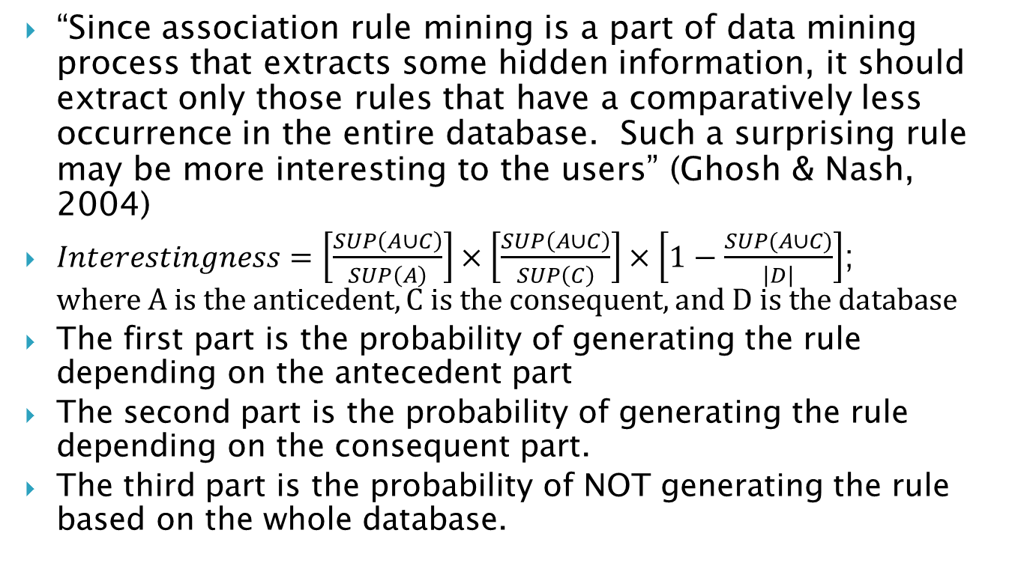
“Interestingness” Objective
“Since association rule mining is a part of data mining process that extracts some hidden information, it should extract only those rules that have a comparatively less occurrence in the entire database. Such a surprising rule may be more interesting to the users” (Ghosh & Nash, 2004)
$Interestingness=\left[\frac{SUP\left(A∪C\right)}{SUP\left(A\right)}\right]×\left[\frac{SUP\left(A∪C\right)}{SUP\left(C\right)}\right]×\left[1−\frac{SUP(A∪C)}{\left|D\right|}\right]$; $where A is the anticedent, C is the consequent, and D is the database$
The first part is the probability of generating the rule depending on the antecedent part
The second part is the probability of generating the rule depending on the consequent part.
The third part is the probability of NOT generating the rule based on the whole database.

Slide 9
Chromosome Encoding
The database has a set of attributes. Each attribute in the chromosome is associated with two tag bits.
00 means the attribute occurs in the antecedent.
11 means the attribute occurs in the consequent.
01 or 10 means the attribute does not occur in the association rule
ACF→BE becomes 00A 11B 00C 01D 11E 00F.
The names of the attributes need not be encoded in the chromosome since their position in the chromosome is fixed.
Categorical valued attributes can be encoded similar to this scheme.
Real valued attributes have a binary encoding scheme.

Slide 10
Fitness and Rank
The fitness value is calculated from the rank, and this is calculated from the non-dominance property of the chromosome.
Non-dominated solutions are ranked as one.
Dominated solutions are assigned a rank of 1+p_{i} , where p_{i} is the number of chromosomes dominating the solution.
Smallest rank gets highest fitness.
Selection, crossover, mutation operators to create new chromosomes. The complete population gets replaced by new generation.

Slide 11
Non-Dominated Solutions Pool
During ranking if non-dominated solutions are found they are put in a separate population pool. This pool is not subject to the genetic operations.
If, after insertion, some of the non-dominated solutions become dominated, they are removed.

Slide 12
Research paper Methodology
Researchers Ghosh and Nath implemented the proposed technique.
They run the algorithm on several databases. They used a sampling technique on the databases.
Researchers present results for one database of 8330 records and 38 attributes. They generated between 24 and 40 rules in from 100 to 300 generations.

Slide 13
Room for Improvement
Researchers offer a suggestion for further research. They point out that in their implementation they use a random sample of the original database to improve efficiency. They point out that the results may not truly reflect the original database. They offer other sampling techniques.

Slide 14
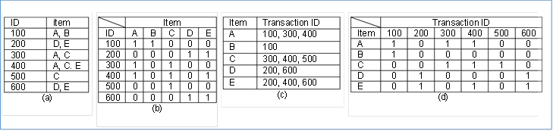
Some Transaction Database Formats
(A) Horizontal format.
(B) Bitmap Horizontal format. Can be sparse matrix.
(C) Vertical format.
(D) Bitmap Vertical format. Can be sparse matrix.

Slide 15
Proposal to Extend Research
It is proposed that a limitation to this algorithms efficiency is the multiple streaming from secondary I/O during every GA generation if a large database was used. This research will investigate methods of fitting a larger part of the database into memory. Possibilities include
Hashing
FP-growth Tree
RLE compression technique using Golumb codes on a transaction database in a bit vector format.
Canonical Huffman compression on a transaction database represented as ID tokens.

Slide 16
Proposed Research Methodology
It is proposed to select and prototype a method to compress a transaction database using Hashing.
The hashing method will be run against several standard databases.
The results will be compared to results already obtained from the Huffman and RLE compression.

Slide 17
References
Agrawal, R., & Srikant, R. (1994). Fast algorithms for mining association rules. In Proc. 20th int. conf. very large data bases, VLDB , (Vol. 1215), 487-499.
Deb, K. (2001). Multi-objective optimization using evolutionary algorithms (Vol. 16). John Wiley & Sons.
Ghosh, A., & Nath, B. (2004). Multi-objective rule mining using genetic algorithms. Information Sciences, 163(1), 123-133.

